Slide 1
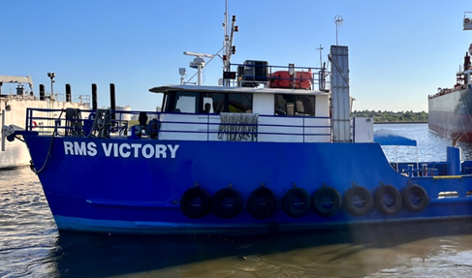
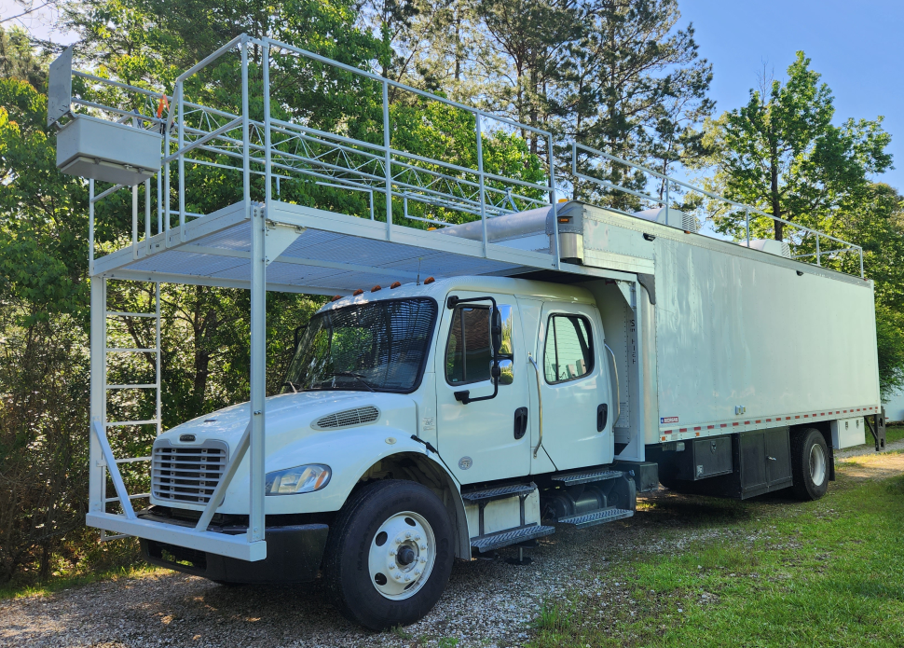
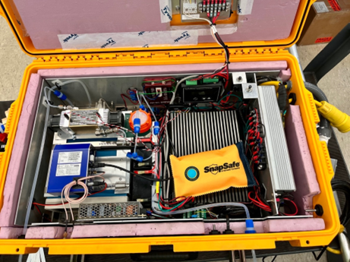
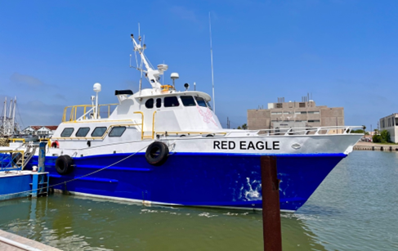
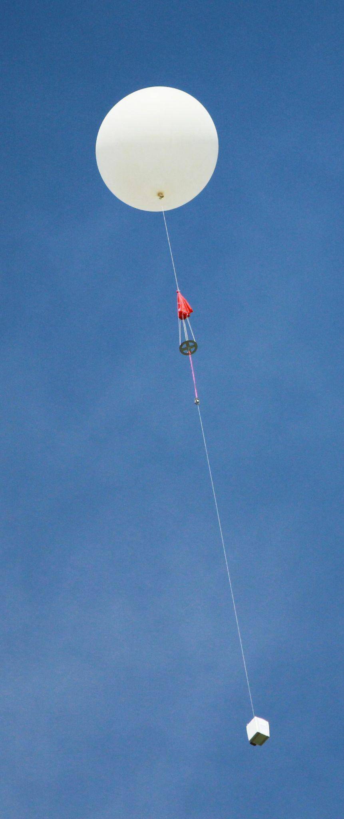
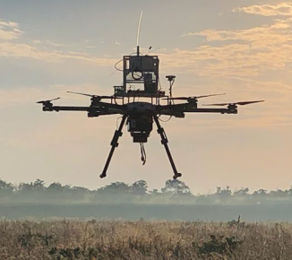
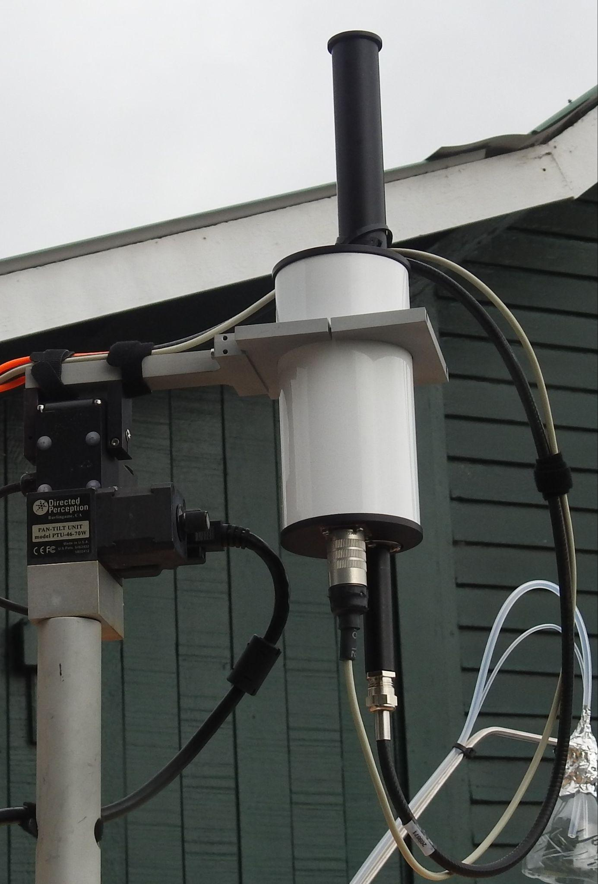
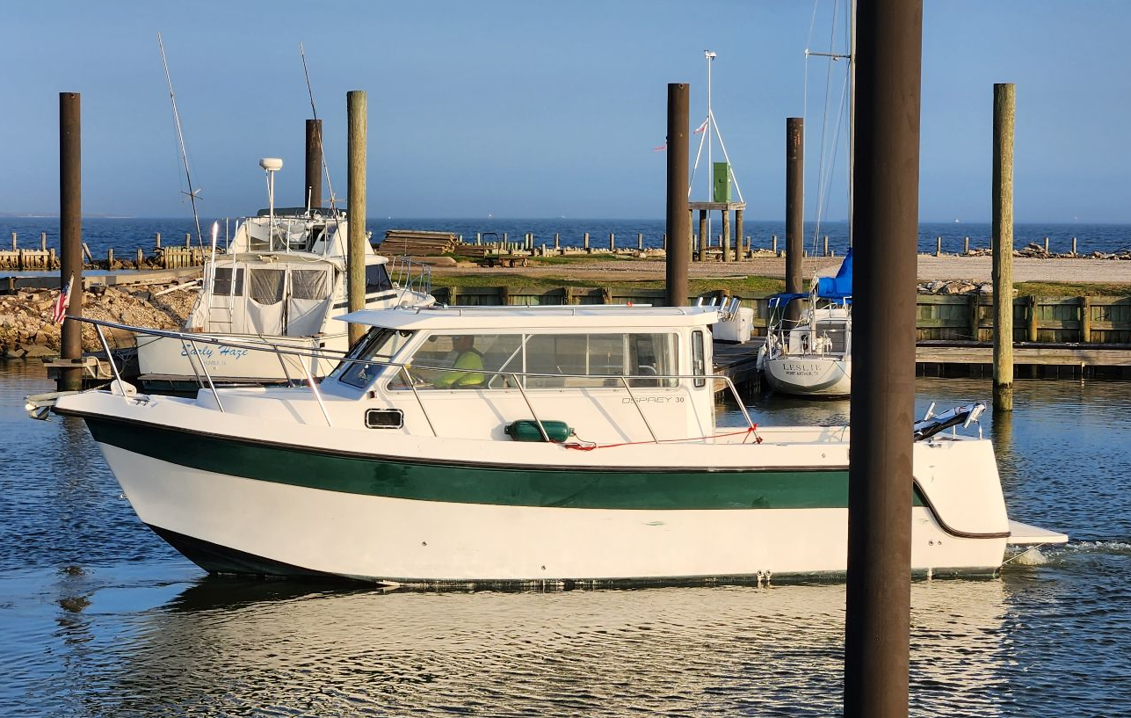
2023 Coastal Texas Air Quality Observations
Goals:
Improve understanding of ozone and particulate matter formation, with a focus on the Houston coastal interface.
Relate surface concentrations to the vertical profile of pollutants, including marine boundary layers.
Build upon 2021 and 2022 TRACER-AQ campaigns.
University of Houston, St. Edward’s University, Baylor University, NASA, Texas Commission on Environmental Quality

Slide 2
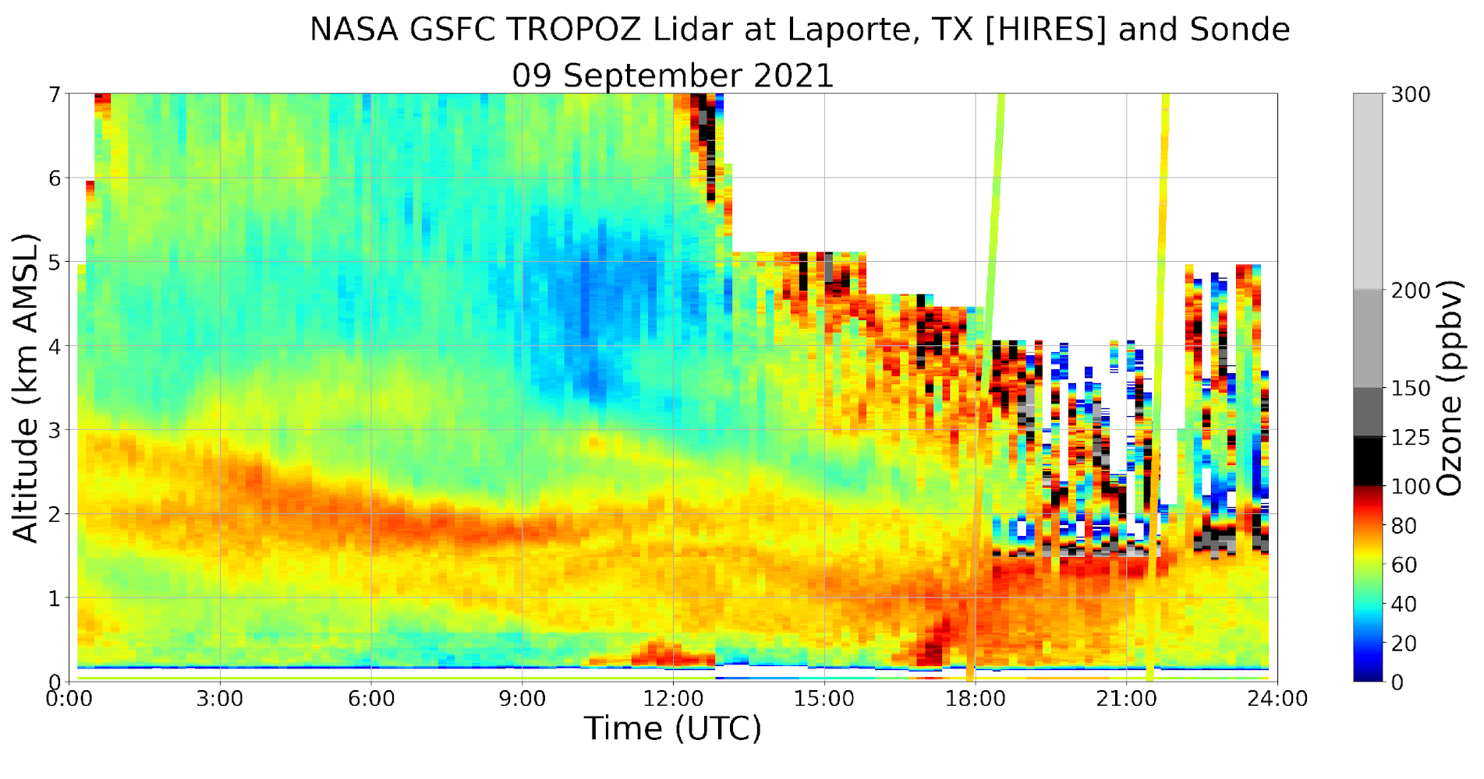
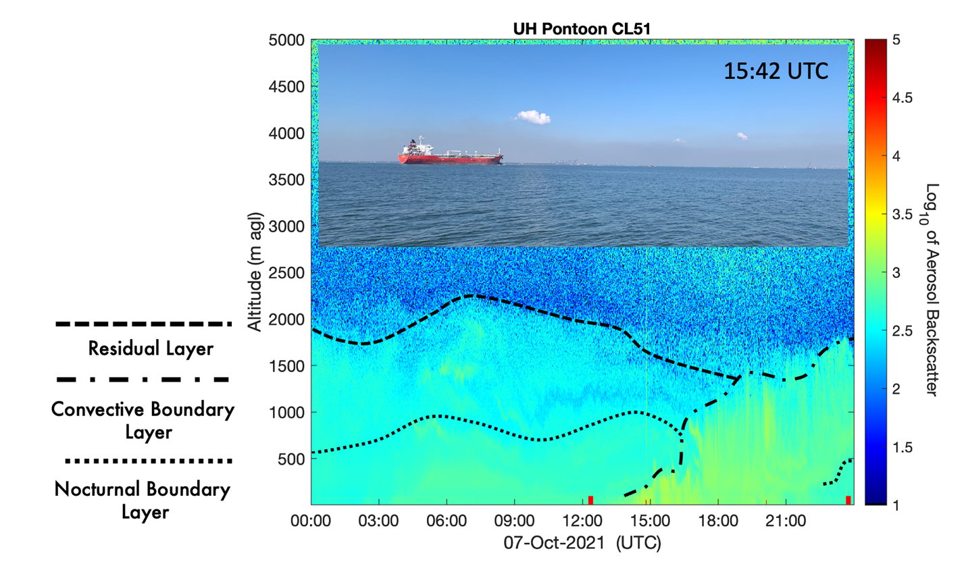
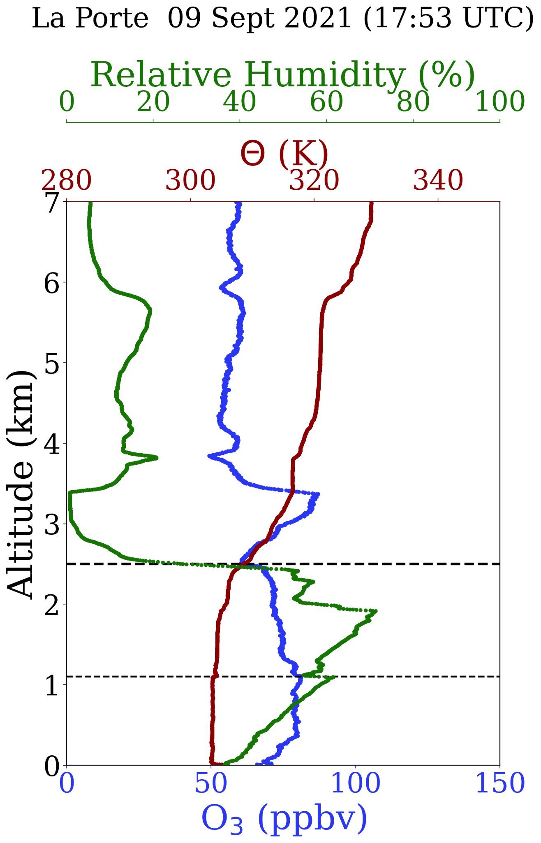
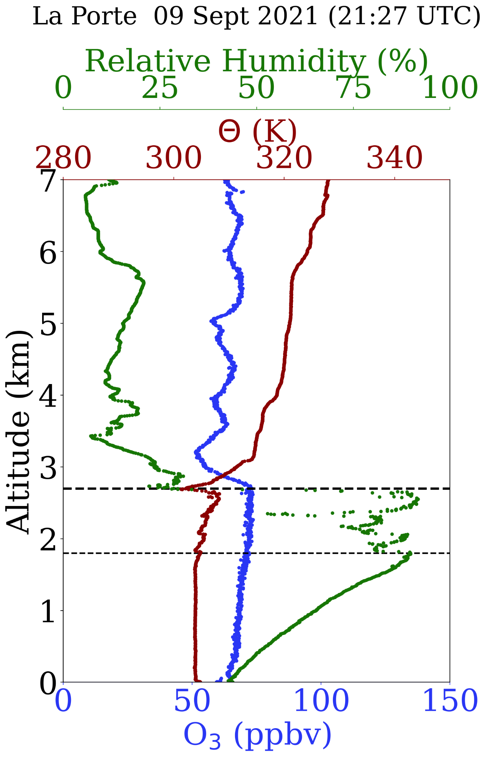
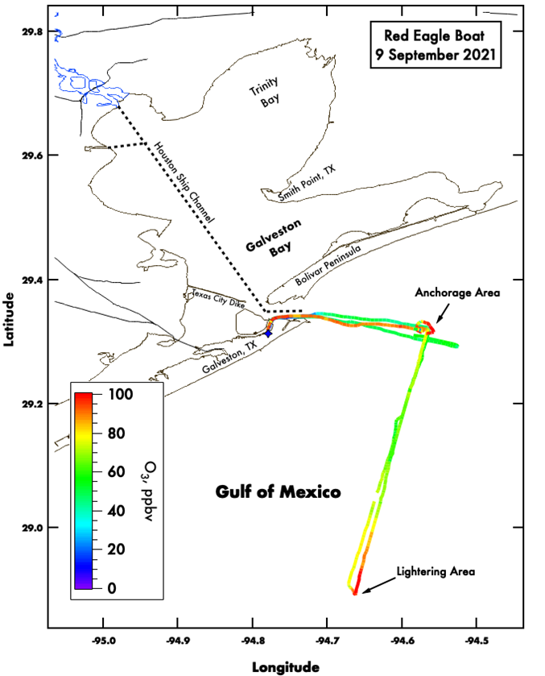
September 9, 2021
Residual layer impact on boundary layer
October 7, 2021
Low boundary layer trapped emissions close to the surface of Galveston Bay.
High frequency TEMPO measurements
Benefits to campaign:
Spatial gradients of air quality in relation to the role of sea/bay breezes and aloft residual layers.
Spatiotemporal variability of the boundary layer
Photochemical model and emissions validation
TEMPO Validation:
On and offshore Pandora and ozonesonde column and profile measurements to evaluate TEMPO retrievals

